Slide 1

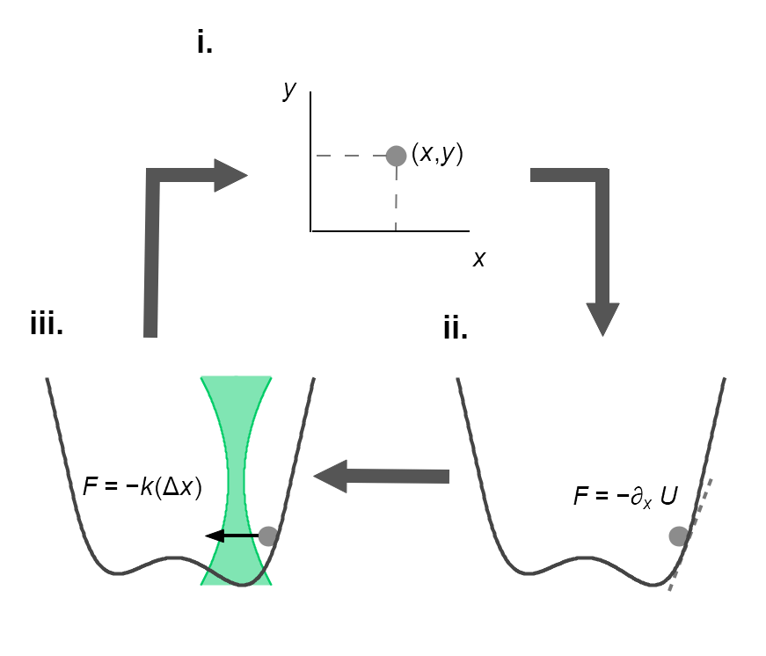
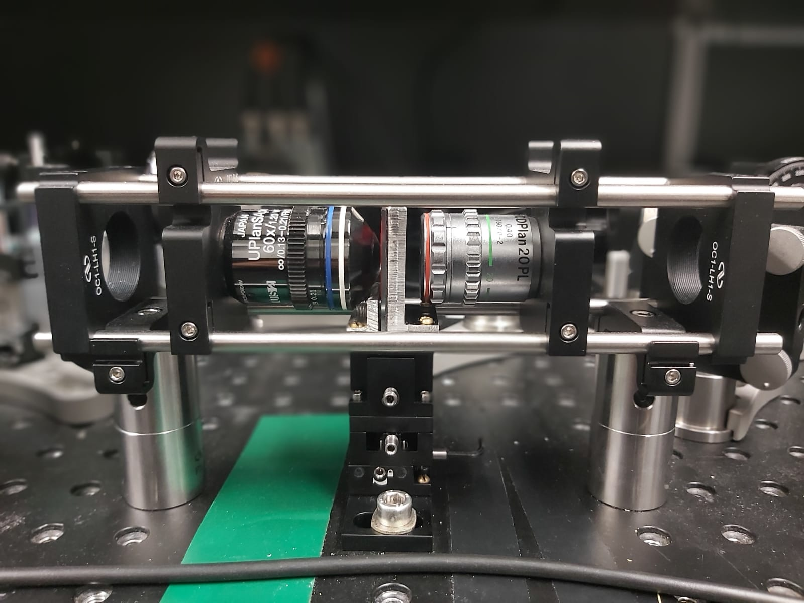
A
B
FPGA
QPD
FI
Host
M
L
L
L
532 nm
M
Trapping
PBS
L
90 %
AOD
L
M
BS
M
SF
Detection
10 %
SC
L
HW
M
M
MO
LED
660 nm
M
MO
DM
L
F
Detection beam
Trapping beam
L
L
Cam
M
M

